Slide 1


Automated Cyber protection for IOT systems using Flow Monitoring and Anomaly Detection
ST.JOSEPH
COLLEGE OF ENGINEERING
DEPARTMENT OF COMPUTER SCIENCE AND ENGINEERING
PRESENTED BY
Chirag
Jone
Rohith
FINAL YEAR B.E (CSE)
GUIDED BY
Mrs. Beneeta

Slide 2
ABSTRACT
As IoT devices become increasingly integrated into our daily lives and critical infrastructure, ensuring their security is paramount to safeguarding sensitive data, preserving privacy, and protecting against potential threats.
Unlike traditional IT systems, IoT devices often have limited computing resources and are deployed in diverse environments, making them susceptible to various security vulnerabilities and exploitation.

Slide 3
ABSTRACT
Data Breaches: Unauthorized access to IoT devices or networks can result in the theft or exposure of sensitive data, including personal information, financial records, and proprietary business data.
Financial Losses: Cyberattacks targeting IoT systems can lead to financial losses due to ransom demands, extortion attempts, business disruptions, and regulatory fines for non-compliance.
Physical Harm: In critical sectors like healthcare, transportation, and infrastructure, security breaches in IoT systems can have life-threatening consequences, causing physical harm or endangering public safety.
This paper discusses a proactive solution to prevent these liabilities before they cause any real harm

Slide 4
OBJECTIVE
To make Securing the IOT systems easier for clients and ensure a safe transitioning for prospective clients
We hope to provide Robust Authentication Mechanisms Automated security updates and intuitive monitoring of the IOT systems to keep you and your data safe

Slide 5
EXISTING SYSTEM
Data Protection and Privacy: IoT systems collect and process vast amounts of data, including personal and sensitive information
Security by Design: Integrating security features and controls into IoT devices and systems from the design stage
Risk Assessment and Management: Conducting regular risk assessments and vulnerability scans
Audit and Reporting: Maintaining accurate records, audit trails, and documentation of security controls, incidents, and compliance efforts.

Slide 6
PROPOSED SYSTEM
Anomaly Detection and Behavioral Analysis
Predictive Threat Intelligence
Adaptive Access Control:
Behavioral Biometrics
Intelligent Threat Hunting
Automated Patch Management
Secure Device Lifecycle Management
Cybersecurity Automation Orchestration

Slide 7
LITERATURE SURVEY

Slide 8
SURVEY PAPER 1
IoT-Enabled Sensors in Automation Systems and Their Security Challenges
(2023)
Abstract
Today IoT based sensor devices are ubiquitous, being cost effective and easy to deploy. These have some security challenges by bypassing established security architectures.

Slide 9
Advantages:
Increased Efficiency: IoT-enabled sensors in automation systems can enhance efficiency by enabling real-time monitoring and control of industrial processes.
Enhanced Productivity: Automation systems empowered by IoT sensors can streamline workflows.
Disadvantages:
Security Vulnerabilities: IoT-enabled sensors in automation systems are susceptible to cyberattacks, posing risks such as data breaches, system disruptions, and even physical harm if compromised
Complexity: Integrating IoT sensors into automation systems can introduce complexity, requiring careful design and implementation to ensure interoperability, reliability.
Privacy Concerns: Collecting and analyzing data from IoT sensors may raise privacy concerns, particularly regarding sensitive information about individuals or proprietary business processes.

Slide 10
SURVEY PAPER 2
Security and Privacy for Low Power IoT Devices on 5G and Beyond Networks Challenges and Future Directions
(2023)
Abstract
It addresses constraints like limited resources and diverse applications, proposing advanced encryption and AI-driven anomaly detection as potential solutions. The aim is to foster secure and privacy-preserving deployments of low-power IoT devices in evolving network environments.

Slide 11
Advantages:
Enhanced Security: Implementing security measures for low-power IoT devices on 5G and beyond networks can significantly improve data protection
Scalability: Developing security and privacy solutions that are scalable to accommodate the increasing number of IoT devices connected to 5G networks
Regulatory Compliance: Meeting regulatory requirements for data protection and privacy, such as GDPR in Europe.
Disadvantages:
Compatibility Issues: Ensuring compatibility between security protocols and IoT devices from different manufacturers may be challenging
Cost: Implementing robust security and privacy measures may increase the cost of IoT devices, potentially limiting their affordability and adoption
Overhead: Security and privacy protocols impose additional overhead on network bandwidth and device resources

Slide 12
H/W REQUIREMENTS
CPU: Intel Core i7 or AMD Ryzen 7 processor with multiple cores and high clock speeds.
RAM: Minimum 16GB DDR4 RAM for handling large datasets and model training.
Storage: SSD with at least 500GB capacity for storing datasets, model checkpoints, and software installations.
Ethernet: Gigabit Ethernet adapter for fast and reliable network connectivity.
Wi-Fi: Dual-band Wi-Fi adapter for wireless communication with IoT devices and edge servers.
Edge Computing Devices:Industrial-grade edge servers or gateways with Intel Xeon or AMD EPYC processors for real-time inference and decision-making at the edge
Security Hardware:Trusted Platform Module (TPM) for hardware-based security features and secure boot capabilities.
Hardware Security Module (HSM) for cryptographic key management and secure storage of sensitive data.

Slide 13
S/W REQUIREMENTS
AI Frameworks and Libraries: TensorFlow for building and training machine learning models.
Scikit-learn for implementing anomaly detection algorithms and feature engineering.
Development Tools: Google Colab for interactive development and experimentation.
Git for version control and collaboration among team members.

Slide 14
ARCHITECTURE DIAGRAM

Slide 15
DATA FLOW DIAGRAM LEVEL 0
Dataset from file
Create model file
Create deep layers
Output layer

Slide 16
DATA FLOW DIAGRAM LEVEL 1
Input
Model
Bias and variance
Plotting
Visual representation

Slide 17
DATA FLOW DIAGRAM LEVEL2
TEST DATA
CREATE MODEL FILE
BIAS DETECTION
VISUALIZATION
BIAS MITIGATION
FINAL OUTPUT
EVALUATION AND TESTING

Slide 18
MODULES AND MODULE DESCRIPTION

Slide 19
MODULES
Data Preparation Module
Model Development Module
Feature Engineering Module
Bias Detection Module

Slide 20
DATA PREPARATION MODULE
Here the CSV file is read and made into data frames for easy use
SAMPLE CSV FILE
DATA
PARSING
DATA PREPROCESSING
PREPROCESSED DATA

Slide 21
MODEL DEVELOPMENT MODULE
Here a Model in this case a Anomaly detection model is created, and the model is saved as a keras file in a temp area for use later
MODEL TRAINING
MODEL
BIAS DETECTION
MODEL SELECTION
TEMP STORAGE
MODEL SAVE

Slide 22
FEATURE ENGINEERING MODULE
The Feature Selection Module involves identifying and retaining the most relevant features from the dataset while discarding redundant or less informative ones and now adding these to the saved model
FEATURE EXTRACTION
PREPROCESSING
FEATURE SELECTION
FEATURE SCALING
FEATURE ENGINEERING
MODEL TRAINING

Slide 23
BIAS DETECTION MODULE
This module uses the given data and sample and calculates the various readings of it like mean median the weight of the features and Accuracy etc.. and finally Visualize it in the form of a some charts
DATA SORTING
OUTPUT
DATA OPERATIONS
FEATURE ENGINEERING
DATA VISUALIZATION

Slide 24
IMPLEMENTATION
Neural Network
1. Initialization:
Create the neural network model: usually involves creating layers and sections for the data to pass through. This serves as the filtering and selection of data.
Initialize a dataset with weights: typically assigning some weight to each sample.

Slide 25
Compile the Model: Compile the model by specifying the optimizer, loss function, and evaluation metrics. The optimizer determines how the model's weights are updated during training,
Train the Model: Train the model on a dataset by feeding it input data and corresponding target labels.
Evaluate the Model: Evaluate the trained model on a separate dataset to assess its performance.
Create data Visualization: Usually some plot maps or heat maps

Slide 26
Autoencoding
Autoencoders: An autoencoder is a type of neural network trained to learn a compressed representation of input data. It consists of two main components: an encoder and a decoder.
Encoder: The encoder compresses the input data into a lower-dimensional representation (encoding). It typically consists of multiple layers, such as convolutional layers or fully connected layers

Slide 27
Decoder: The decoder reconstructs the original input data from the compressed representation produced by the encoder. It mirrors the structure of the encoder but in reverse, gradually expanding the representation back to the original dimensionality.
Training: Autoencoders are trained using unsupervised learning techniques, where the objective is to minimize the reconstruction error between the input data and the output of the decoder.

Slide 28
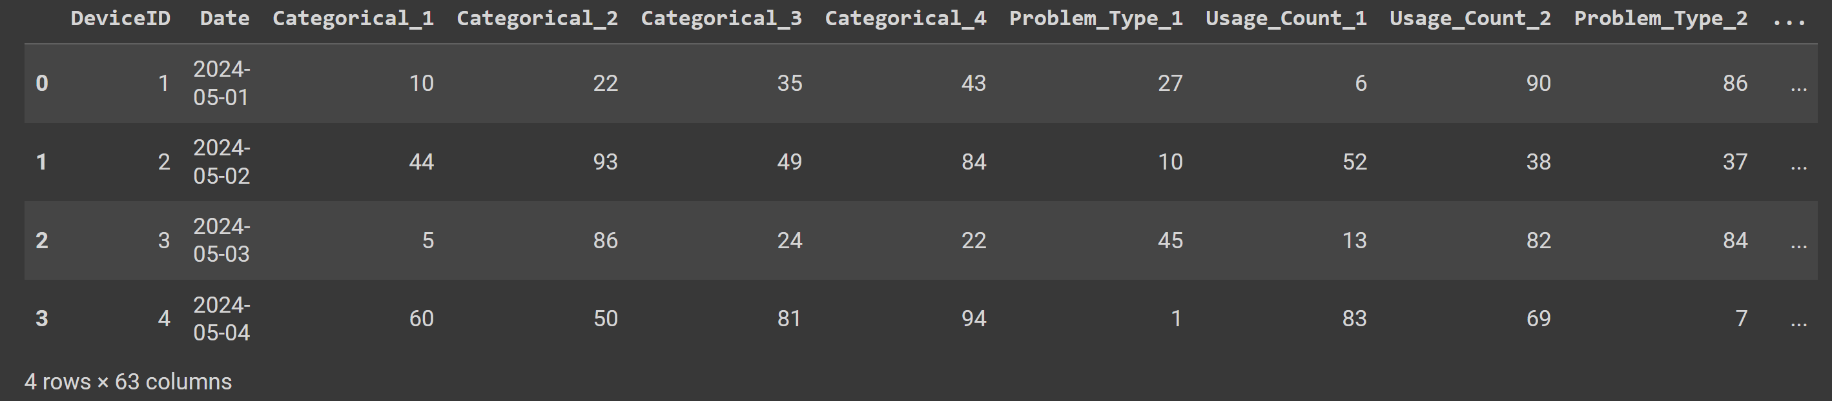
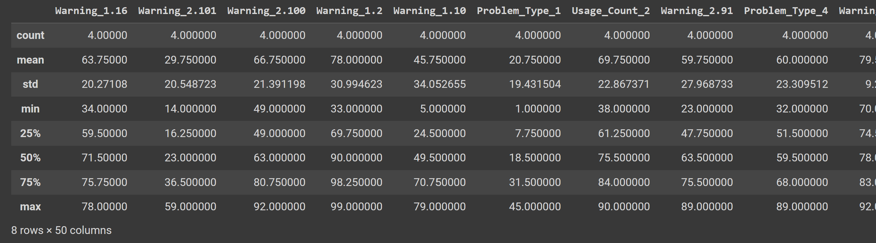
OUTPUT

Slide 29
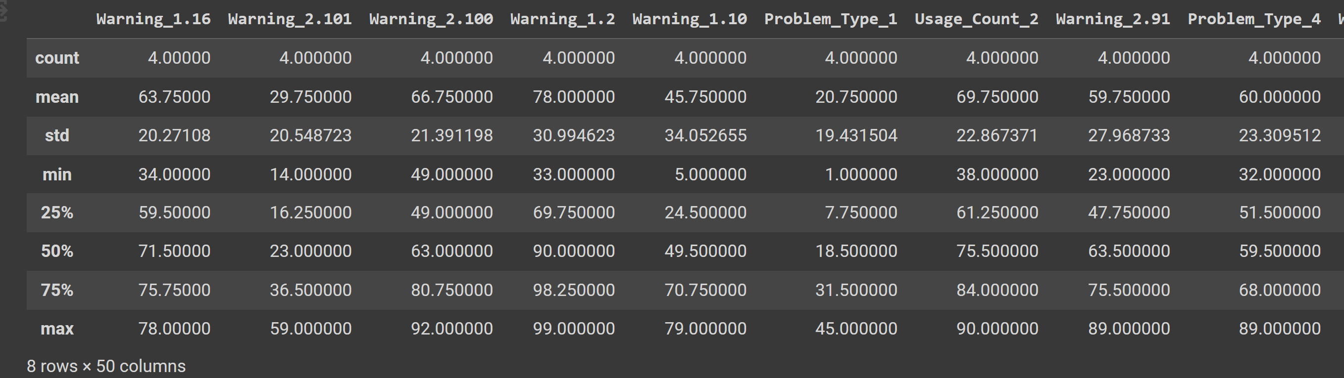
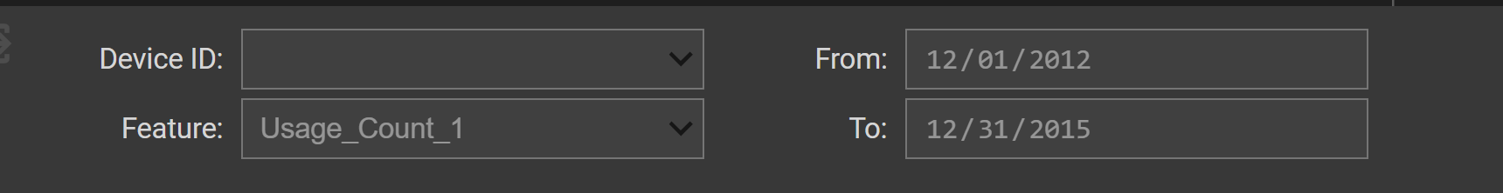
OUTPUT

Slide 30
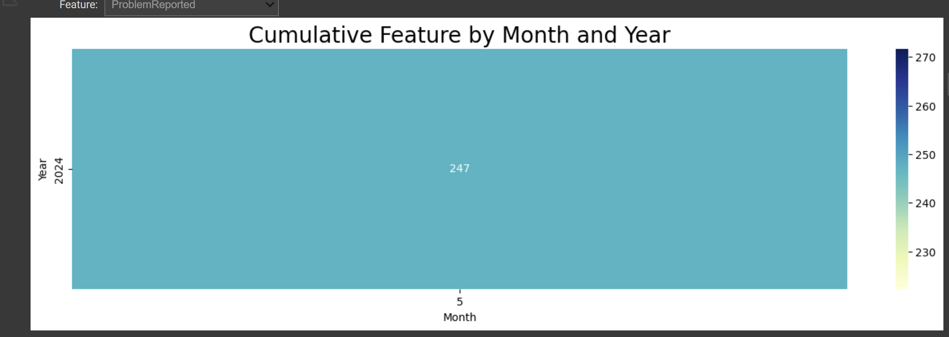
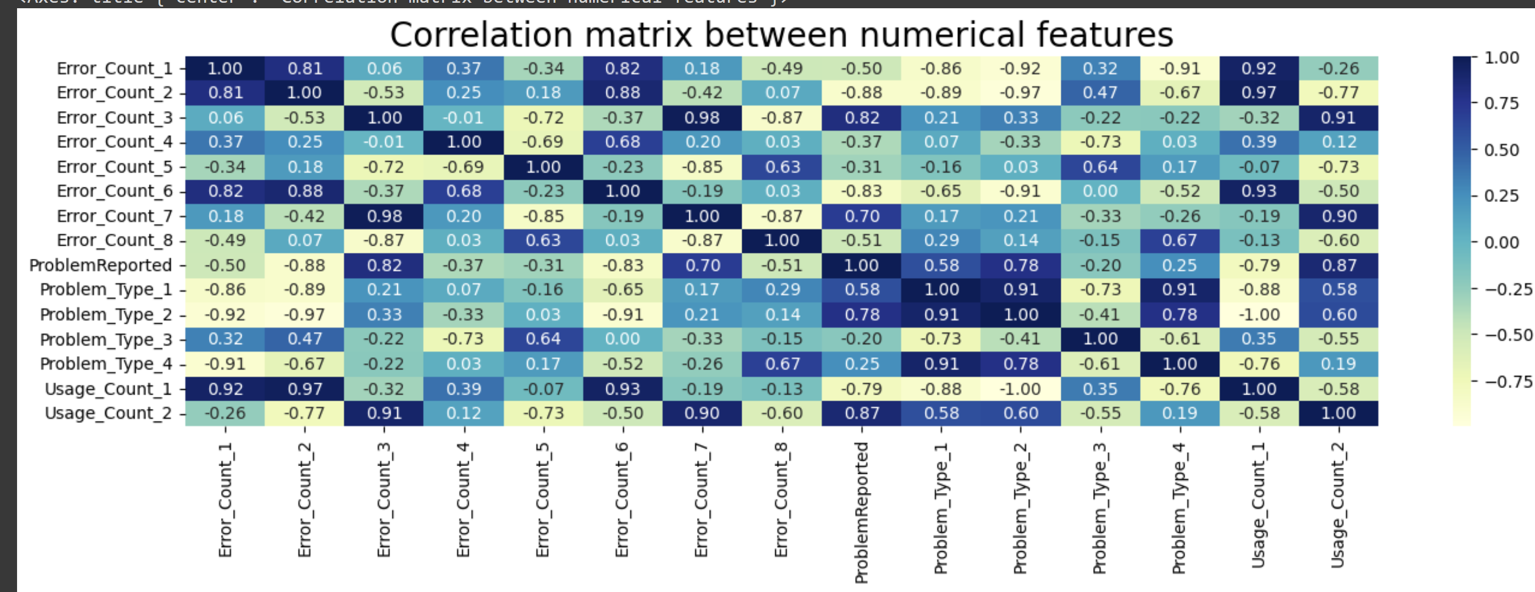
OUTPUT

Slide 31
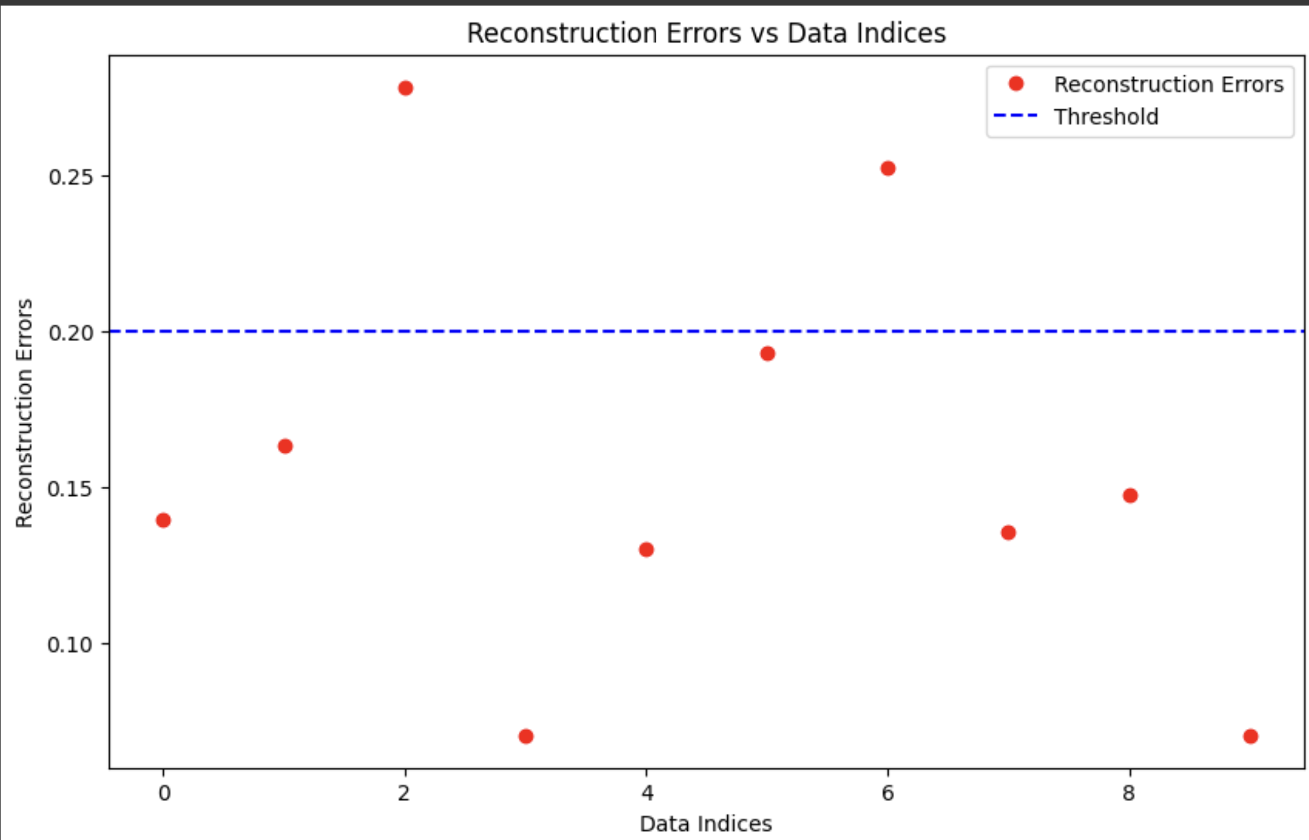
OUTPUT

Slide 32
Conclusion
Thus the proposed system can detect anomalies proactively and predict the type of anomalies that can appear in the different IOT systems
This can save clients a lot of investments by avoiding a attack or vulnerability altogether

Slide 33
FUTURE ENHANCEMENTS
Enhanced Bias Detection Algorithms: Incorporate advanced machine learning algorithms and techniques for more accurate and comprehensive bias detection.
Predictive Analytics: Extend the framework to include predictive analytics capabilities, allowing for the anticipation of potential biases and proactive mitigation strategies.
Interactive Design : Create a interactive platform in which users can make intiuitive changes and perform experiment

Slide 34
Thank you for your time, we know it is precious to you!

